Slide 1
Reproducible Research with Evidence-based Data Analysis
Roger D. Peng, PhD
Department of Biostatistics
Johns Hopkins Bloomberg School of Public Health
@simplystats, http://simplystatistics.org
BIRS 2013
Notes:
I’m going to pull a David Brillinger and not talk about reproducible research

Slide 2

Coming Soon!

Slide 3
Replication and Reproducibility
Replication
Reproducibility
Focuses on the validity of the scientific claim
“Is this claim true?”
The ultimate standard for strengthening scientific evidence
New investigators, data, analytical methods, laboratories, instruments, etc.
Particularly important in studies that can impact broad policy or regulatory decisions
Focuses on the validity of the data analysis
“Can we trust this analysis?”
Arguably a minimum standard for any scientific study
New investigators, same data, same methods
Important when replication is impossible

Slide 4
Background: Underlying Trends
Some studies cannot be replicated: No time, No money, Unique/opportunistic
Technology is increasing data collection throughput; data are more complex and high-dimensional
Existing databases can be merged to become bigger databases (but data are used off-label)
Computing power allows more sophisticated analyses, even on “small” data
For every field “X” there is a “Computational X”

Slide 5
The Result?
Even basic analyses are difficult to describe
Heavy computational requirements are thrust upon people without adequate training in statistics and computing
Errors are more easily introduced into long analysis pipelines
Knowledge transfer is inhibited
Results are difficult to replicate or reproduce
Complicated analyses cannot be trusted

Slide 6
What is Reproducible Research?
Author
Published Article
Nature
Protocol
Express train to nature
Scientific Question
Reader

Slide 7
What is Reproducible Research?
Author
Presentation code
Processing code
Analytic code
Figures
Measured Data
Analytic Data
Computational Results
Tables
Published Article
Nature
Numerical Summaries
Text
Protocol
Scientific Question
Reader
Notes:
Authors and Readers want to go in opposite directions
Why don’t we meet in the middle?

Slide 8
What Problem Does Reproducibility Solve?
What we get
What we do not get
Transparency
Data Availability
Software / Methods Availability
Improved Transfer of Knowledge
Validity / Correctness of the analysis
An analysis can be reproducible and still be wrong
We want to know “can we trust this analysis?”
Does requiring reproducibility deter bad analysis?
Notes:
There are many examples of analyses that were reproducible but still wrong. Yes, but we discovered them! So what? What has been the impact of discovering that an analysis is bad? Yes, it’s better than nothing, but wouldn’t we rather prevent bad analysis?

Slide 9
Problems with Reproducibility
The premise of reproducible research is that with data/code available, people can check each other and the whole system is self-correcting
Addresses the most “downstream” aspect of the research process – post-publication
Assumes everyone plays by the same rules and wants to achieve the same goals (i.e. scientific discovery)

Slide 10
An Analogy from Asthma
Allergen Exposure
Specific IgE + sensitized mast cells
Inflammatory mediators (histamine, leukotrienes)
Vasodilation, mucous (symptoms), bronchoconstriction
Environmental Intervention
Anti-IgE
Anti-mediator
Anti-inflammatory
Medication

Slide 11
Scientific Dissemination Process
Research conducted (problematic?)
Paper submitted to journal
Paper publication
Post-publication review
Editor’s judgment
Peer review
Reproducible research
“Medication”
Notes:
If there’s a problem with an analysis, reproducible research allows someone to discover it. Wouldn’t it be better if the analysis were done right in the first place?

Slide 12
Scientific Dissemination Process
Research conducted (problematic?)
Paper submitted to journal
Paper publication
Post-publication review
???
Editor’s judgment
Peer review
Reproducible research
“Medication”
Notes:
If there’s a problem with an analysis, reproducible research allows someone to discover it. Wouldn’t it be better if the analysis were done right in the first place?
We need to SHIFT OUR EFFORTS to focus on the red box.

Slide 13
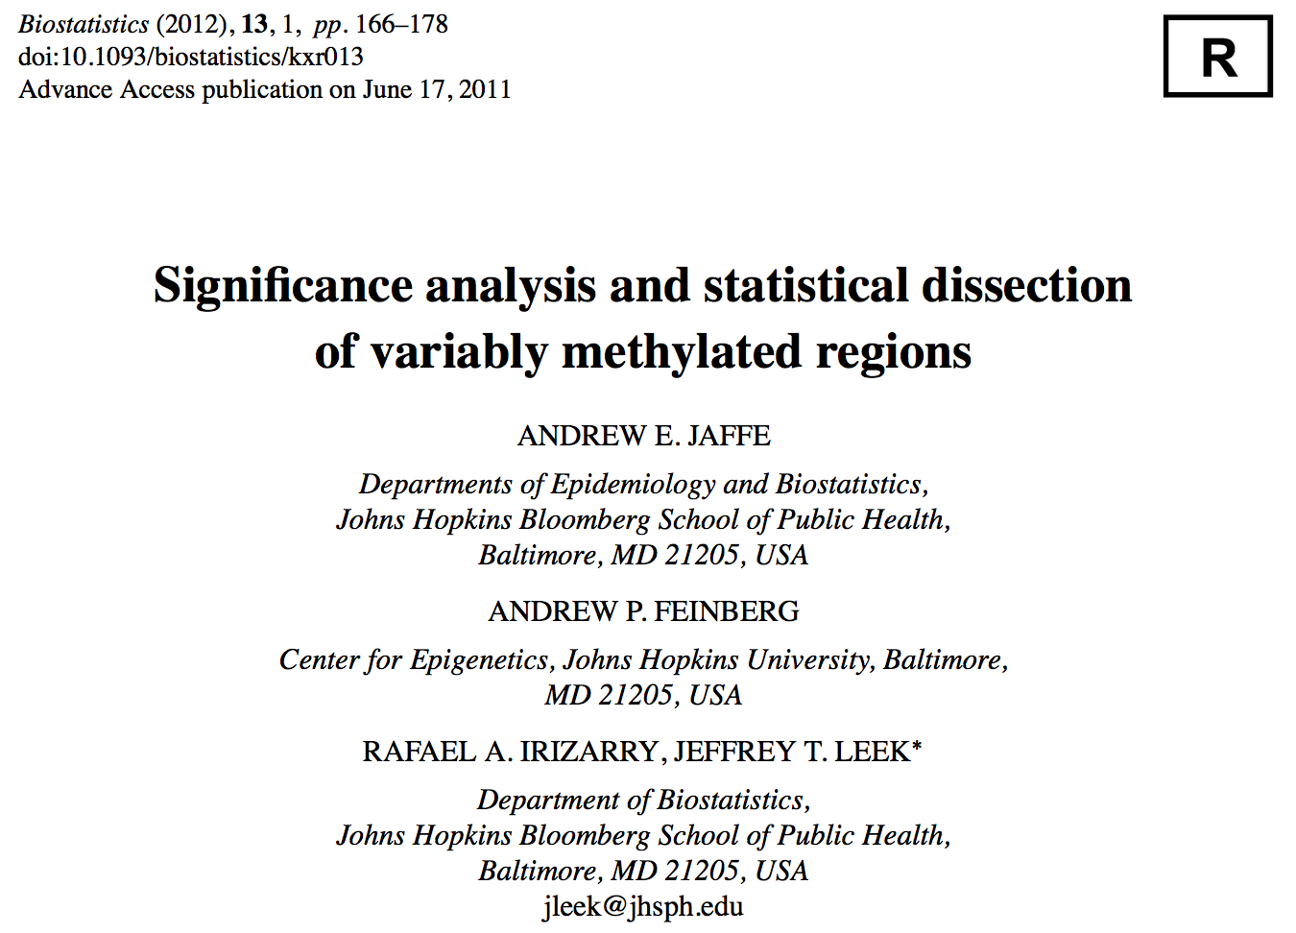
Reproducible Research at Biostatistics

Slide 14
Who Reproduces Research?
For reproducibility to be effective as a means to check validity, someone needs to do something
Re-run the analysis; check results match
Check the code for bugs/errors
Try alternate approaches; check sensitivity
The need for someone to do something is inherited from traditional notion of replication
Who is “someone” and what are their goals?
Notes:
You’re only going to get involved if you have an interest in the area. It’s okay if your interest is in the scientific truth, but what if it’s not?

Slide 15
Who Reproduces Research?
Original Investigator
Reproducers
I don’t care
General Public
The truth is A
The truth is A
Scientists
The truth is B
The truth is not A
???
Notes:
Size of the box is proportional to the interest in “reproducing” your work

Slide 16
The Story So Far
Reproducibility brings transparency (wrt code+data) and increased transfer of knowledge
A lot of discussion about how to get people to share data
Key question of “can we trust this analysis?” is not addressed by reproducibility
Reproducibility addresses potential problems long after they’ve occurred (“downstream”)
Secondary analyses are inevitably coloured by the interests/motivations of others

Slide 17
Evidence-based Data Analysis
Most data analyses involve stringing together many different tools and methods
Some methods may be standard for a given field, but others are often applied ad hoc
We should apply thoroughly studied (via statistical research), mutually agreed upon methods to analyze data whenever possible
There should be evidence to justify the application of a given method

Slide 18
Evidence-based Histogram Bin Width
Sturges HA (1926), JASA
Scott DW (1979), Biometrika
Notes:
Suppose someone wrote their own function to invert a matrix. Why????

Slide 19
Evidence-based Data Analysis
Create analytic pipelines from evidence-based components – standardize it
A Deterministic Statistical Machine http://goo.gl/Qvlhuv
Once an evidence-based analytic pipeline is established, we shouldn’t mess with it
Analysis with a “transparent box”
Reduce the “researcher degrees of freedom”
Analogous to a pre-specified clinical trial protocol
Notes:
Clinical protocols are very detailed – except for the data analysis part which is full of vague generalities

Slide 20
Deterministic Statistical Machine
Methods section
Dataset
Report
Preprocessing
Model Selection
Sensitivity analysis
Output parameters
Input metadata
Benchmark dataset
Benchmark dataset
Benchmark dataset
Public repository

Slide 21
Case Study: Estimating Acute Effects of Ambient Air Pollution Exposure
Acute/short-term effects typically estimated via panel studies or time series studies
Work originated in late 1970s early 1980s
Key question: “Are short-term changes in pollution associated with short-term changes in a population health outcome?”
Studies usually conducted at community level
Long history of statistical research investigating proper methods of analysis

Slide 22
New York Data

Slide 23
Case Study: Estimating Acute Effects of Ambient Air Pollution Exposure
Can we encode everything that we have found in statistical/epidemiological research into a single package?
Time series studies do not have a huge range of variation; typically involves similar types of data and similar questions
We can create a deterministic statistical machine for this area?

Slide 24
DSM Modules for Time Series Studies of Air Pollution and Health
Check for outliers, high leverage, overdispersion
Fill in missing data? NO!
Model selection: Estimate degrees of freedom to adjust for unmeasured confounders
Other aspects of model not as critical
Multiple lag analysis
Sensitivity analysis wrt
Unmeasured confounder adjustment
Influential points
Dominici, McDermott, Hastie (2004) JASA; Peng, Dominici, Louis (2006) JRSS-A

Slide 25
DSM Output

Slide 26
Where to Go From Here?
One DSM is not enough, we need many!
Different problems warrant different approaches and expertise
A curated library of machines providing state-of-the art analysis pipelines
A CRAN/CPAN/CTAN/… for data analysis
Or a “Cochrane Collaboration” for data analysis

Slide 27
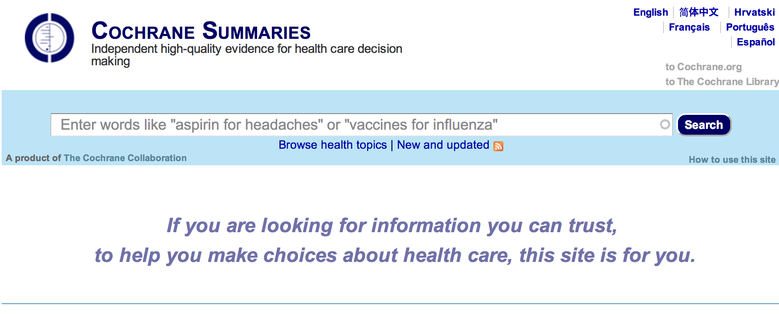
Cochrane Collaboration

Slide 28
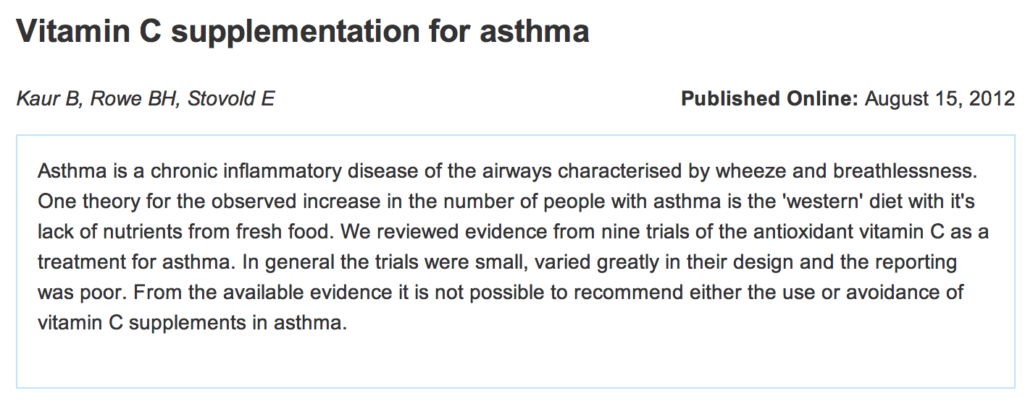
Cochrane Collaboration

Slide 29
A Curated Library of Data Analysis
Provide packages that encode data analysis pipelines for given problems, technologies, questions
Curated by experts knowledgeable in the field
Documentation/references given supporting each module in the pipeline
Changes introduced after passing relevant benchmarks/unit tests

Slide 30
Summary
Reproducible research is important, but does not necessarily solve the critical question of whether a data analysis is trustworthy
Reproducible research focuses on the most “downstream” aspect of research dissemination
Evidence-based data analysis would provide standardized, best practices for given scientific areas and questions
Gives reviewers an important tool without dramatically increasing the burden on them
More effort should be put into improving the quality of “upstream” aspects of scientific research

